Slide 1
Vision-Based Object Detection and Distance Calculation in Autonomous Vehicles
Name of the Guide:
Dr. G REVATHY
Assistant Professor
GROUP MEMBERS:
K Bhavyasree - 225003193
Manthra P M - 225003208
Sowmiya G - 225003144

Slide 2
BASE PAPER DETAILS :
Simultaneous Object Detection and Distance Estimation for Indoor Autonomous Vehicles
AUTHORS :
Iker Azurmendi
Ekaitz Zulueta
Jose Manuel Lopez-Guede
Manuel González
PUBLISHED: November 21, 2023
INDEXED: Electronics, Volume 12, Issue 4719

Slide 3
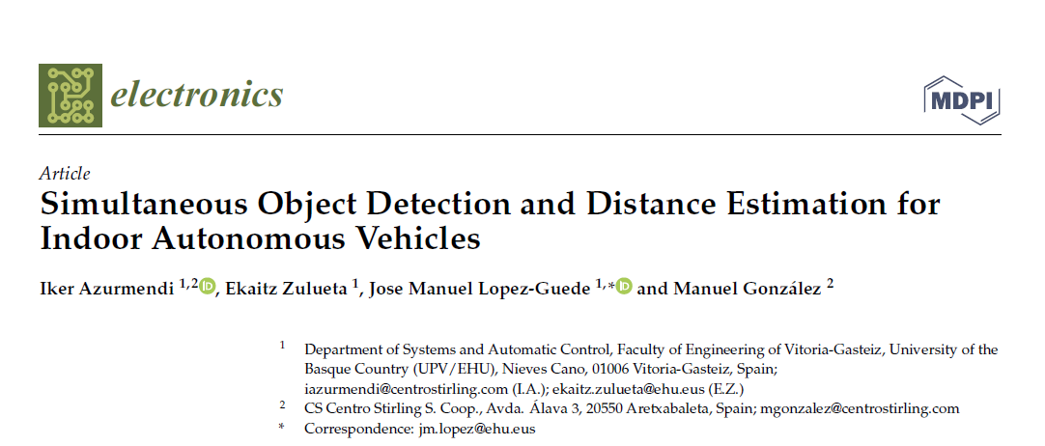

Slide 4
This project aims to develop and test algorithms for simultaneous object detection and distance estimation in indoor autonomous vehicles.
The proposed method will utilize YOLOv5 and its variants, YOLOv8, SSD models, and a hybrid approach using a custom dataset and KITTI dataset for training, along with the KITTI dataset for other models.
Data augmentation and transfer learning techniques will be applied to improve model performance and adaptability.
The evaluation will focus on comparing and assessing the models based on precision, recall, F1-score, and mAP at IoU thresholds of 0.5 and 0.95.
The goal is to provide a reliable and cost-effective solution for accurate obstacle detection and distance estimation in indoor environments for autonomous systems.
ABSTRACT:

Slide 5
PROBLEM STATEMENT :
Autonomous vehicles struggle to detect and avoid obstacles inside buildings.
Measuring the distance to obstacles accurately using regular cameras is difficult, reducing system reliability.
LiDAR sensors are too expensive for many systems.
Collecting labeled data for training models takes too much time.
High-performing algorithms need costly hardware, making them less accessible.
.

Slide 6
LITERATURE REVIEW :
SI No | Research Article | Journal, year | Methodology | Advantages | Disadvantages
1 | Simultaneous Object Detection and Distance Estimation for Indoor Autonomous Vehicles | Electronics in 2023. | Deep learning-based object detection and distance estimation. | cost-effective object detection and distance estimation using a monocular camera, achieving high accuracy with a custom dataset by transfer learning and data augmentation. | Different YOLOv5 variants perform differently, making model selection for deployment more complex.
2 | Object detection in adverse weather condition for autonomous vehicles | Multimedia Tools and Applications on August 22, 2023 | Image enhancement using ESRGAN, detection with YOLOv7. | Autonomous vehicles aim to improve traffic flow and efficiency. | The hybrid approach may have high computational requirements and image upscaling could reduce resolution.
3 | Vehicle detection and traffic density estimation using ensemble of deep learning models | Multimedia Tools and Applications in August 2022. | ensemble of Faster R-CNN and SSD models . | ensemble model offers improved vehicle detection and traffic density estimation results compared to the base models. | higher computational complexity and longer inference time compared to the base models of SSD and Faster R-CNN..

Slide 7
SI No | Research Article | Journal ,year | Methodology | Advantages | Disadvantages
4 | You Only Look Once: Unified, Real-Time Object Detection | IEEE Access in 2016 | YOLO frames object detection as regression. | YOLO is fast, processes the entire image, and learns general object representations. | YOLO has lower accuracy in localizing small objects and struggles to detect multiple nearby objects.
5 | Moving Object Detection With Deep CNNs | IEEE Access in 2020. | fine grained framework for moving object detection and identification | better performance on high-resolution video, with a 2.6x speedup using Tiny YOLOv3. | Deep learning struggles with high-resolution scenes, background subtraction is sensitive to modeling.
6 | Object Detection Method Using Image and Number of Objects on Image as Label | IEEE Access in 2023. | reinforcement learning-based A2C approach. | The method adapts to new environments without needing bounding boxes. | It requires a pre-trained evaluation model and can’t classify object types.

Slide 8
SI No | Research Article | Journal, year | Methodology | Advantages | Disadvantages
7 | End-to-End Object Detection with Transformers | ECCV in 2020. | DETR uses transformers for set-based detection. | DETR simplifies detection, is easy to implement, and matches Faster R-CNN performance on COCO. | lower performance on small objects and requires a longer training schedule and additional losses for optimal performance.
8 | EfficientDet: Scalable and Efficient Object Detection | IEEE Access in June 2020 | integrates BiFPN, compound scaling, and EfficientNet to develop EfficientDet models. | faster inference, state-of-the-art COCO accuracy, and better Pascal VOC segmentation | Prior object detectors were too computationally expensive.
9 | Improved YOLOv8n for Foreign-Object Detection in Power Transmission Lines | IEEE Access in 2024. | Improved YOLOv8n with ECA attention mechanism and small object detection module. | Improved accuracy, fast detection speed, and high robustness | Increased complexity and reduced performance.

Slide 9
SI No | Research Article | Journal ,Year | Methodology | Advantages | Disadvantages
10 | Improved Vision-Based Vehicle Detection and Classification by Optimized YOLOv4 | IEEE Access in January 2022. | Improving the YOLOv4 object detection model by incorporating an CBAM and modifying the FPN component. | Improved object detection and classification performance compared to state-of-the-art models | Limitations include training data size, fixed input size, confidence thresholding, spatial constraints, difficulty with unusual object shapes for bounding box prediction.
11 | A Survey of Deep Learning-Based Object Detection Methods and Datasets for Overhead Imagery | IEEE Access in 2022 | comprehensive survey of deep learning-based object detection methods and datasets for overhead imagery | It surveys deep learning-based object detection methods and datasets for overhead imagery, covering both satellite and aerial images. | difficulty in detecting small objects and oriented objects, which can lead to decreased detection performance.

Slide 10
WORK PLAN:
Data Collection
Data Preparation
Create Training Dataset
Implementation of YOLOv5-its variants,YOLOv8,SSD models and hybrid approach for Training & Testing
Object Detection and Distance Estimation Results
Metrics Results and Performance Analysis
Documentation and Reporting

Slide 11
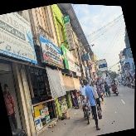


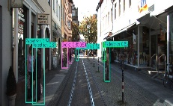
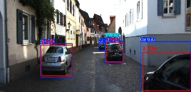
METHODOLOGY ARCHITECTURE:
KITTI dataset + custom indoor dataset
Data Acquisition
Augmentation(custom only)
Data Preprocessing
Format conversion
Convert labels to YOLO & SSD format.
Model Training
KITTI dataset → Train YOLOv5 (s, m, n, l), YOLOv8, SSD and Hybrid model(YOLOv5 + YOLOv8).
Custom dataset → Hybrid model (YOLOv5 + YOLOv8)
Dataset
Split dataset into training ,validation and testing
Model Architecture
11
Performance Evaluation
Metrics and compare models
Distance Estimation
Object Detection
Calculates object distances.
Generates depth maps using Depth Estimation Model

Slide 12
METHODOLOGY USED:
Data Acquisition:
The dataset consists of the KITTI dataset and a custom indoor dataset.
custom dataset is collected in an indoor environment, capturing different obstacle scenarios.
Data Preprocessing:
Data augmentation techniques are applied to increase the custom dataset from 100 to 500 images using flipping, brightness adjustments, and noise addition.
Labels are converted into the required format(YOLO and SSD) for model compatibility.
Training and Testing:
The dataset is split into training and testing subsets.
Pretrained YOLOv5(s, m, n and l), YOLOv8, and SSD models are trained on the KITTI dataset and hybrid approach is used on both the datasets to improve object detection and distance estimation performance.

Slide 13
METHODOLOGY USED:
Model Architecture:
The methodology integrates YOLOv5( s, m, n and l), YOLOv8, SSD, and a hybrid model for object detection and distance estimation.
Distance estimation is performed using a depth estimation model, which generates a simulated depth map for calculating object distances based on detected bounding boxes.
Performance Evaluation:
Model performance is evaluated using Precision, Recall, F1-score, and mean Average Precision (mAP) at IoU(Intersection Over Union) 0.5 & 0.95.
Compare YOLOv5, YOLOv8, and SSD based metrics and performance. use confusion matrices and precision, recall curves for better visualization.
Final Model Selection:
The best-performing model is selected based on results for object detection and distance estimation reliability, and the final model is optimized for obstacle detection and distance estimation in indoor autonomous vehicles.

Slide 14
DATASET DESCRIPTION:
KITTI Dataset - Version 1
Total Files: 52.5k (.png files:30.0k and .txt files: 22.5k)
Source : Kaggle dataset
Image Type : .png, .jpg
Size of image : 1242 x 375
URL :https://www.kaggle.com/datasets/klemenko/kitti-dataset
Custom Dataset
Total Images: 100 images initially
Data Augmentation: Increased the dataset to 500 images using augmentation.
Image Format: .png
Source: Custom collected dataset

Slide 15
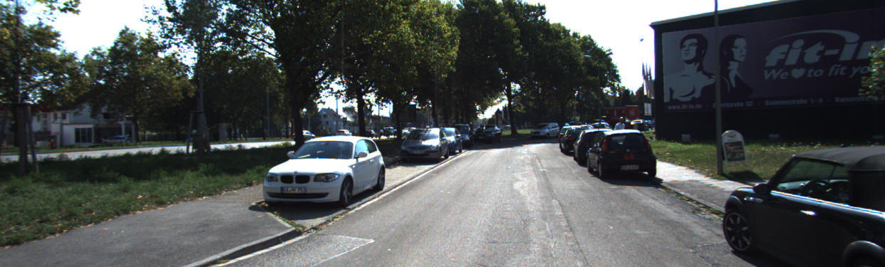
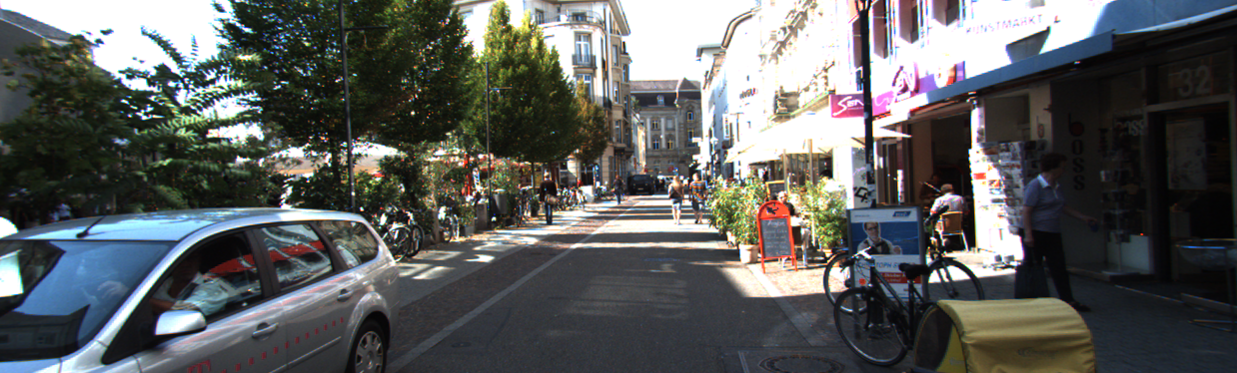
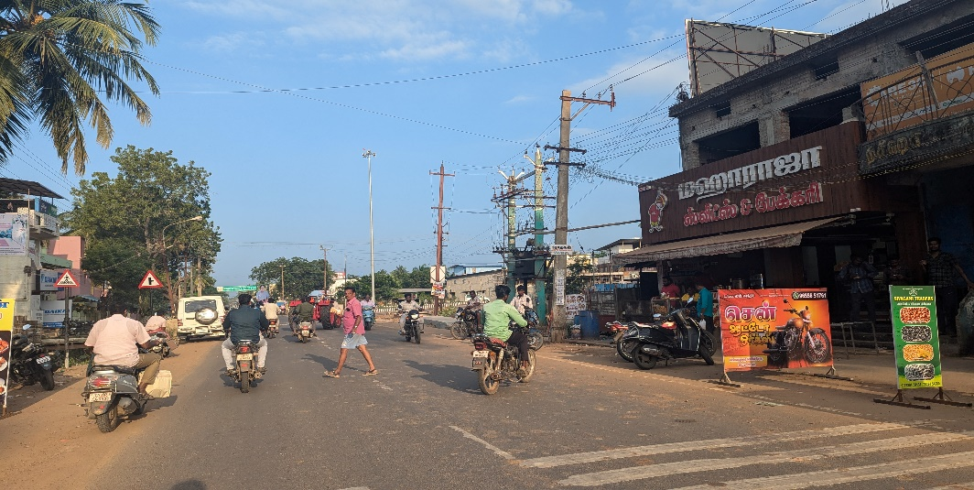
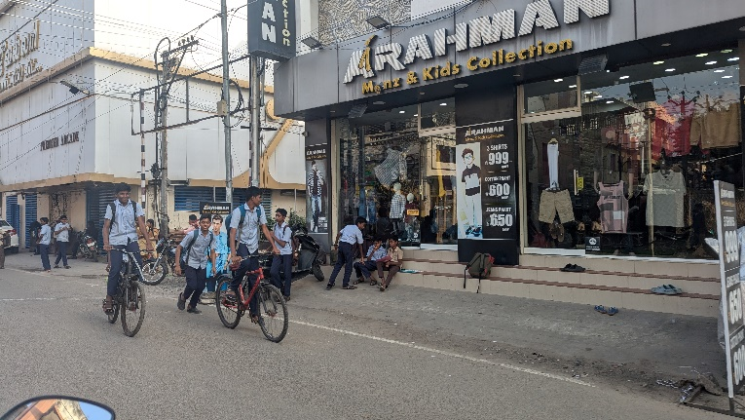
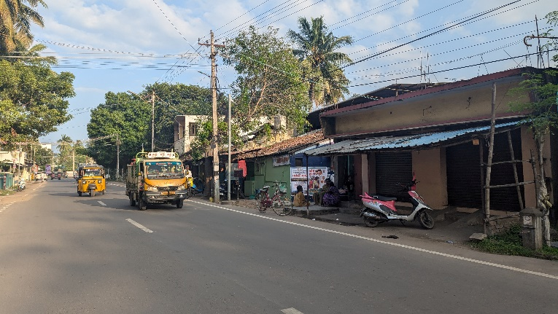
DATASET COLLECTION:
Kitti Dataset:
Custom Dataset:

Slide 16
Work Flow(Previous):
Data Collection:
Collected and Used KITTI dataset
Data Preprocessing:
Converted labels into YOLO format
Model Training:
Trained YOLOv5 (s, m, n, l) and YOLOv8 on the dataset
Used pretrained weights for better accuracy
Object detection and distance estimation using depth estimation model
Model Evaluation:
Measured Precision, Recall, F1-score, mAP@50, mAP@50-95
Compared YOLOv5 vs YOLOv8 for performance

Slide 17
Work Flow:
Current work:
Training SSD model on the KITTI dataset and convert the labels into SSD format.
Hybrid Model → Combine YOLOv5 & YOLOv8 for better detection and training it through custom dataset and KITTI dataset.(apply data augmentation steps).
Object detection and distance estimation.
Evaluation metrics and choose best model based on performance.

Slide 18
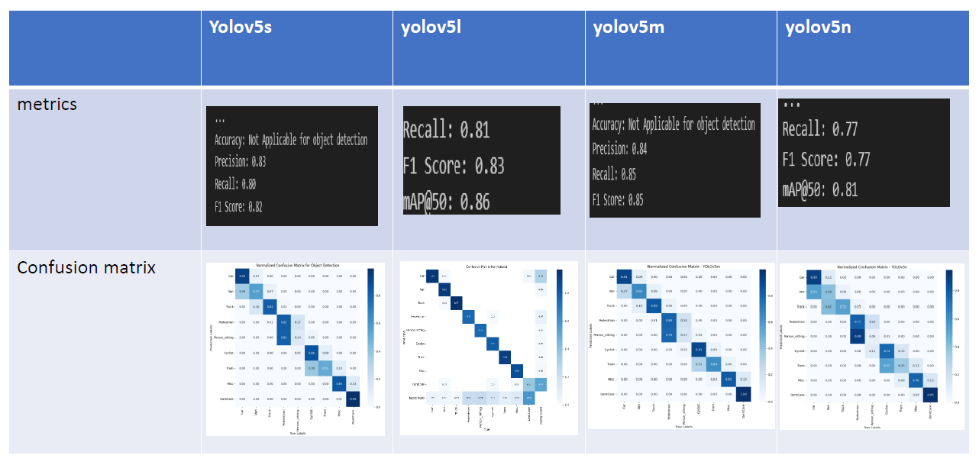
Implementation (Demo And Screenshots):

Slide 19
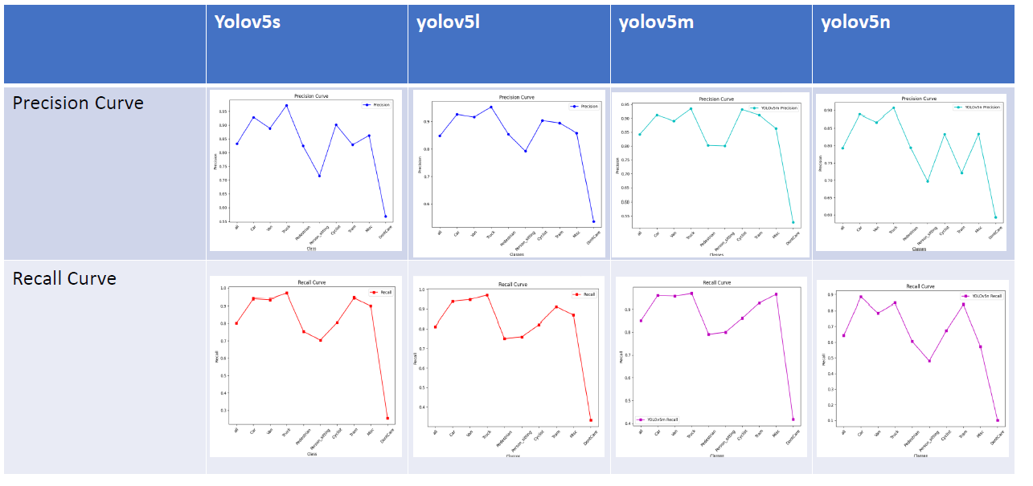
Implementation (Demo And Screenshots):

Slide 20
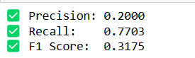
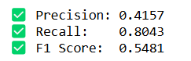
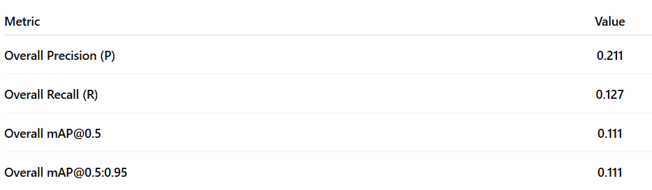
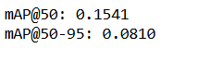
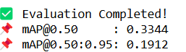
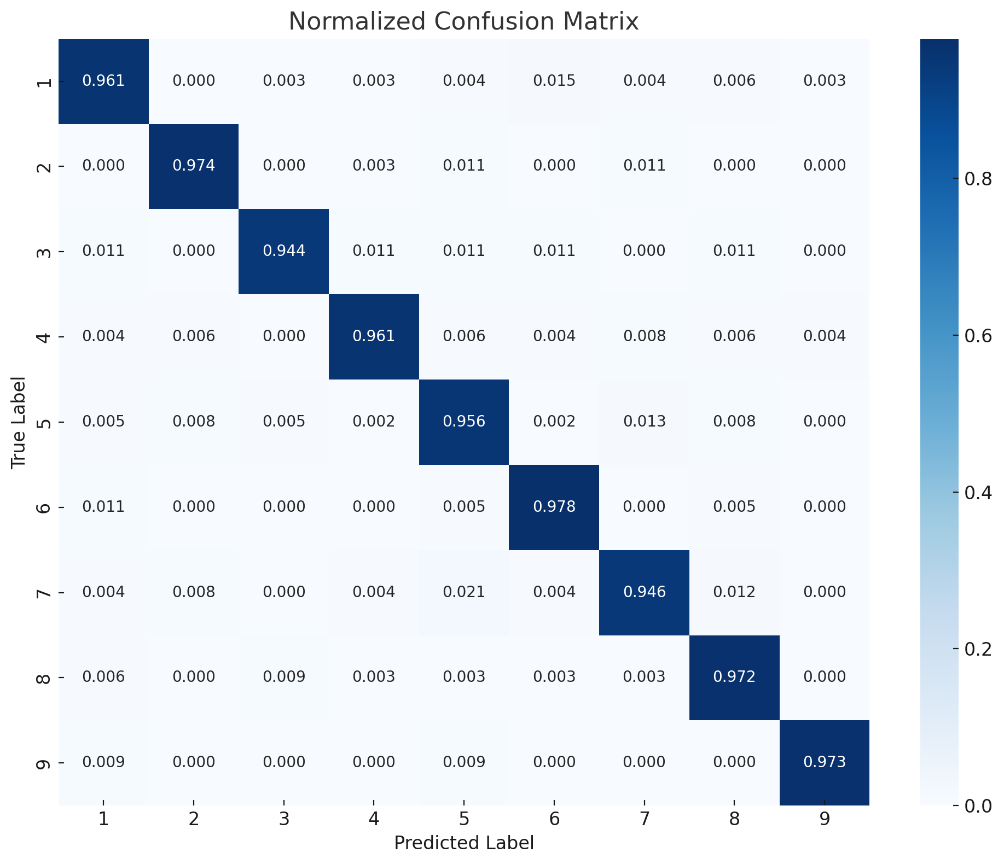
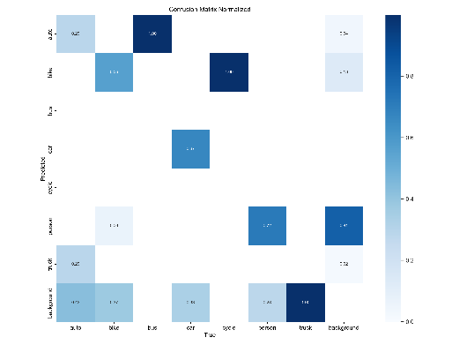
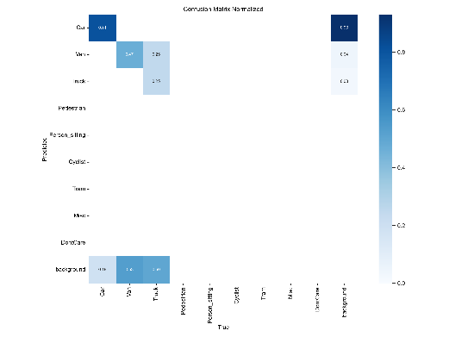
Implementation (Demo And Screenshots):
 | SSD model | Yolov5+yolov8 using custom dataset | Yolov5+yolov8 using KITTI dataset
metrics
Confusion matrix

Slide 21
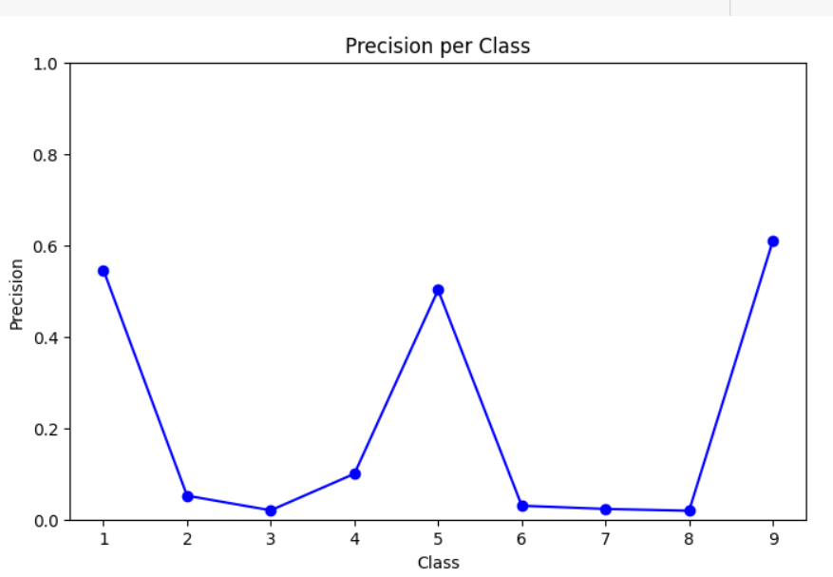
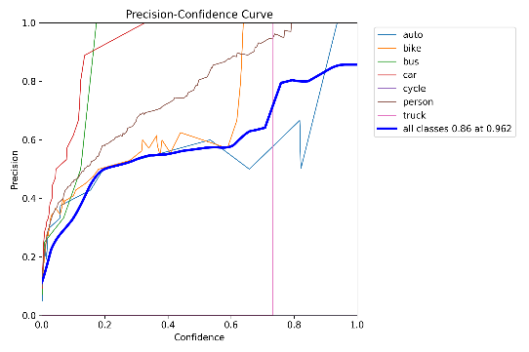
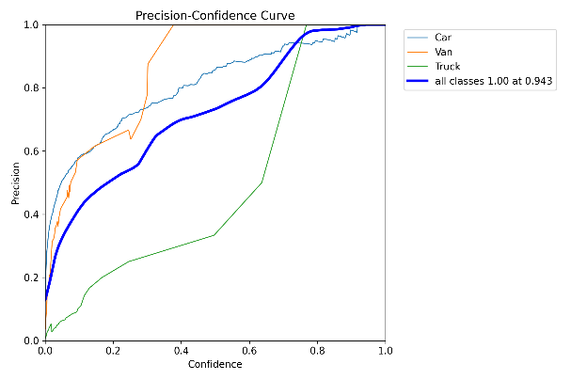
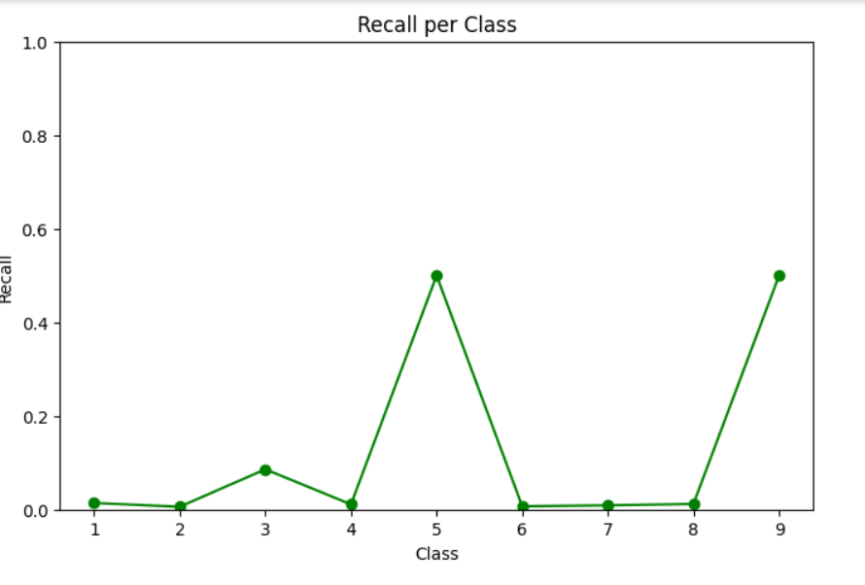
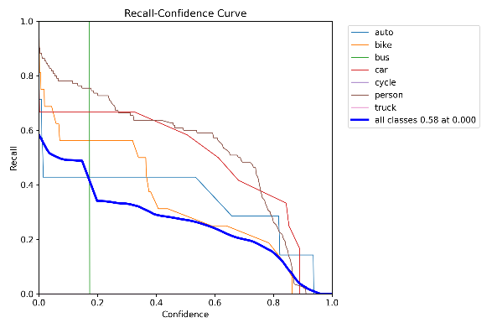
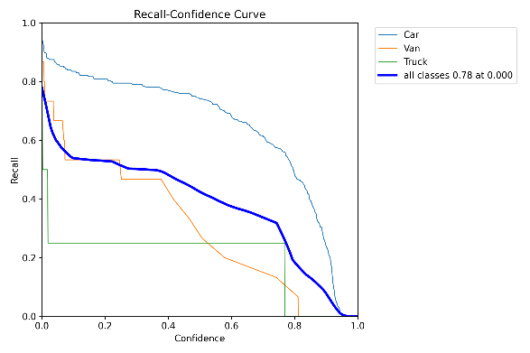
Implementation (Demo And Screenshots):
 | SSD | Yolov5+yolov8 using custom dataset | Yolov5+yolov8 using KITTI dataset
Precision Curve
Recall Curve

Slide 22
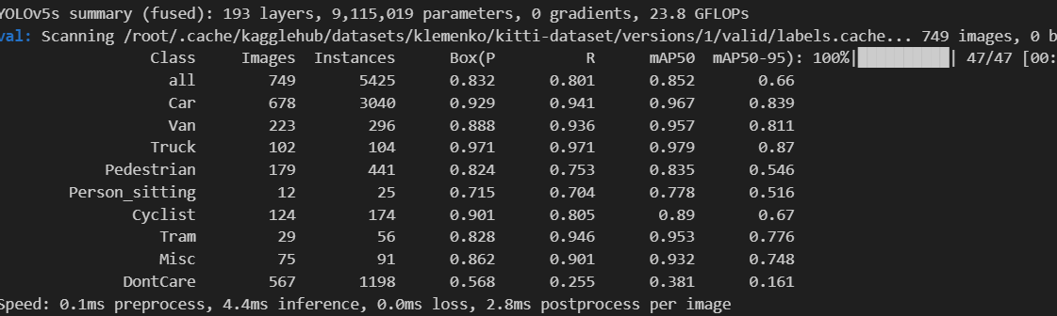
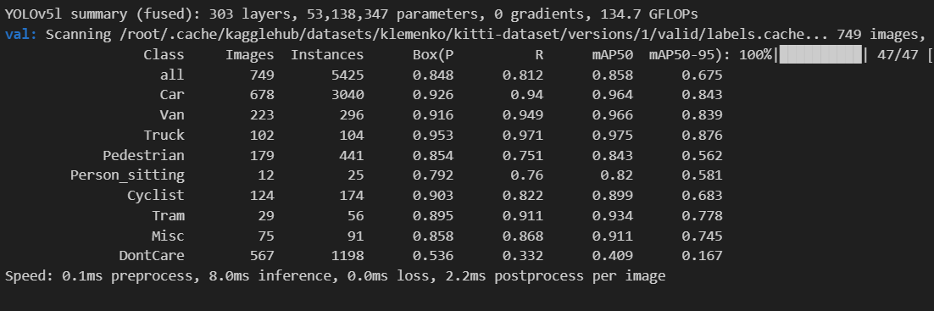
Implementation (Demo And Screenshots):
Yolov5s summary
Yolov5l summary

Slide 23
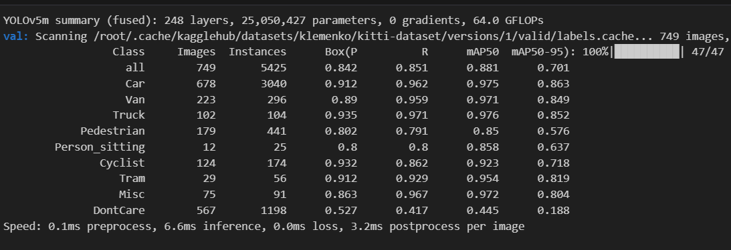
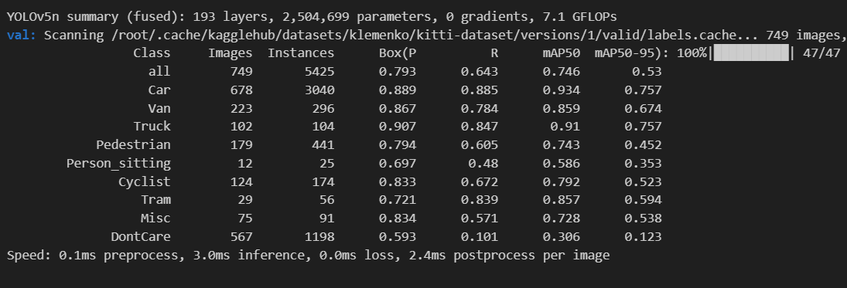
Implementation (Demo And Screenshots):
Yolov5m summary
Yolov5n summary

Slide 24
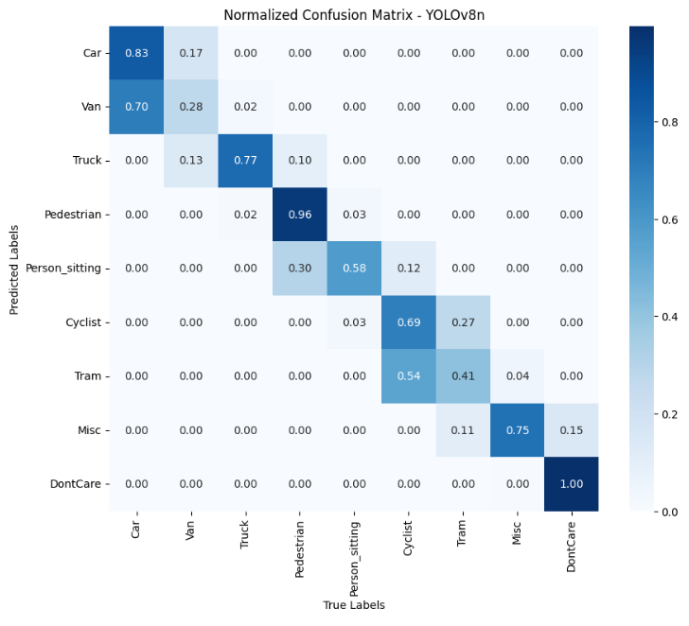
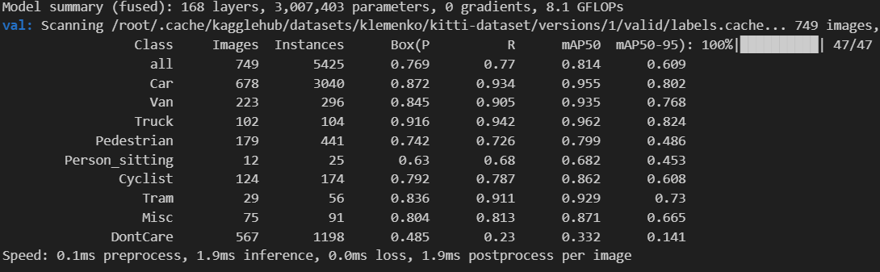
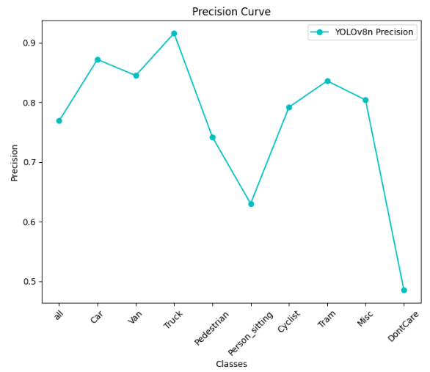
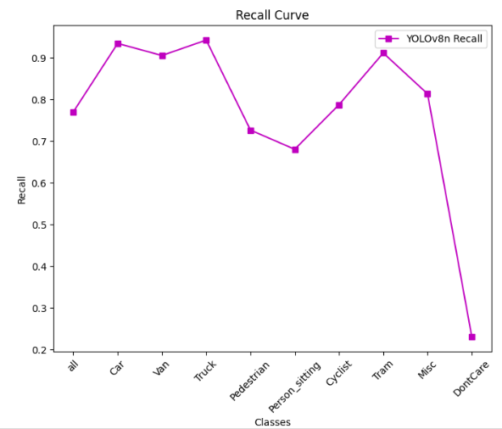
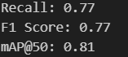
Implementation (Demo And Screenshots):
Yolov8n summary

Slide 25
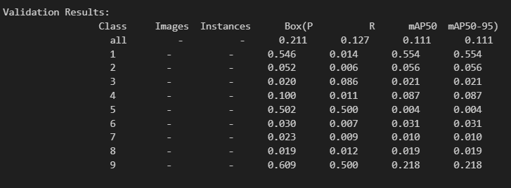
Implementation (Demo And Screenshots):
SSD summary

Slide 26
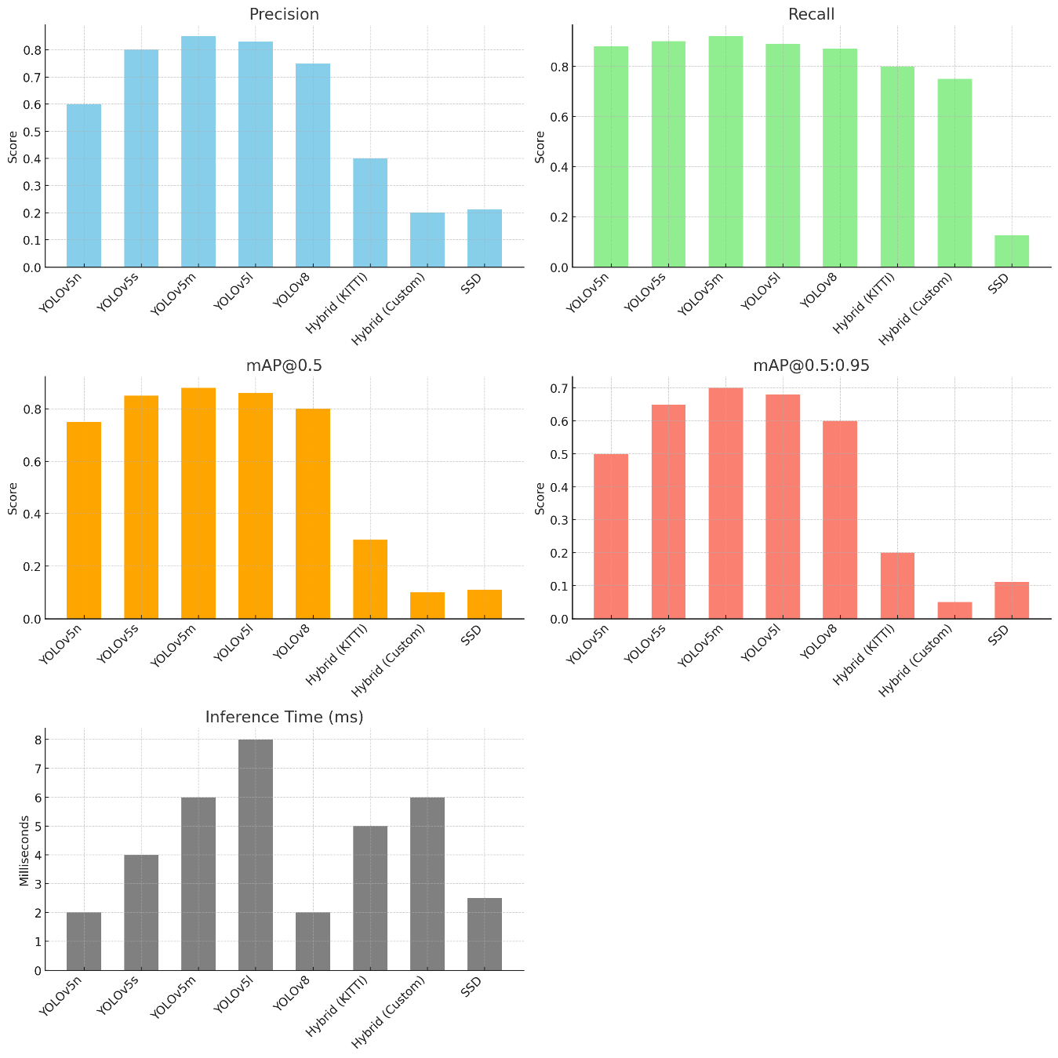
Implementation (Demo And Screenshots):
Model Comparison:

Slide 27
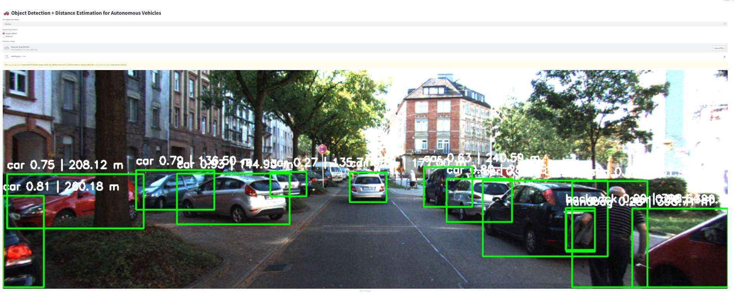
Frontend Implementation:

Slide 28
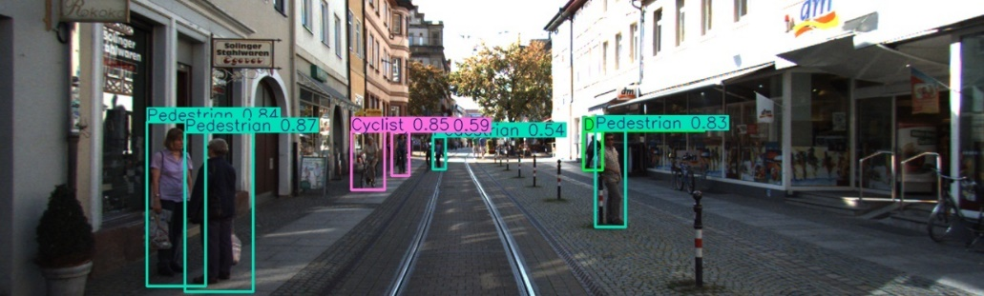
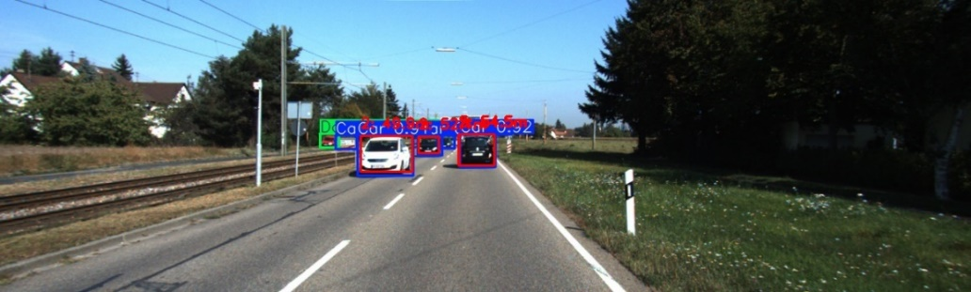
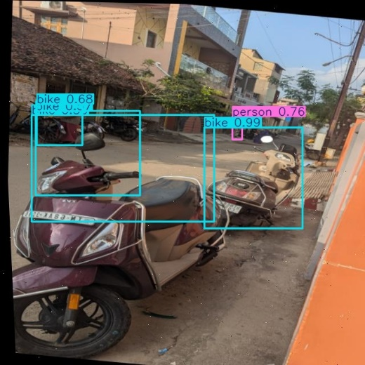
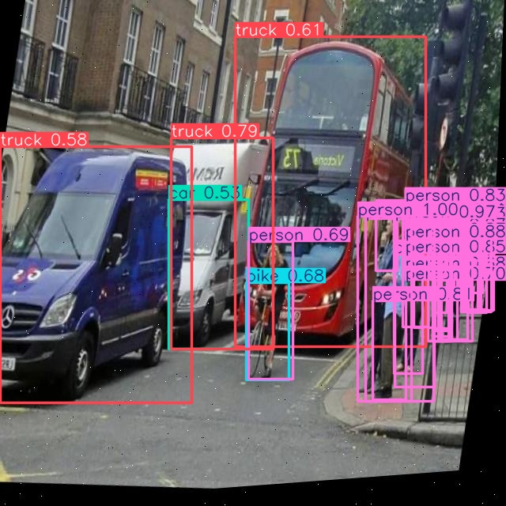
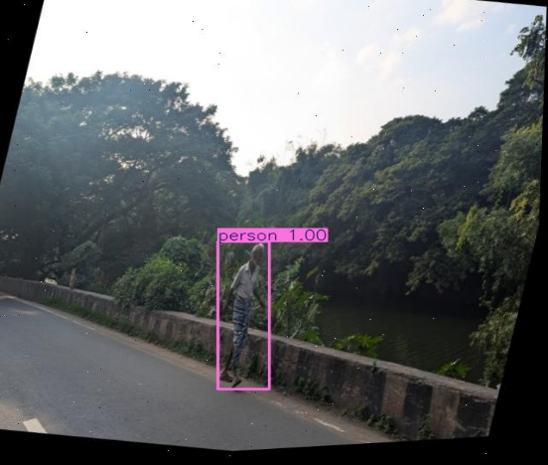
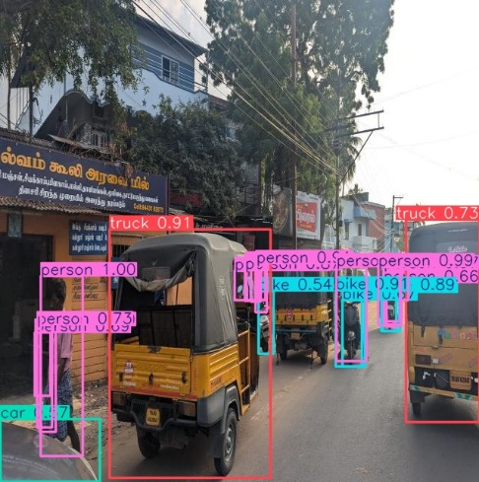
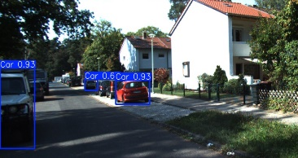
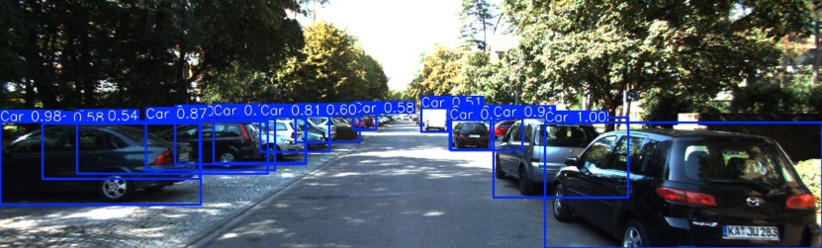
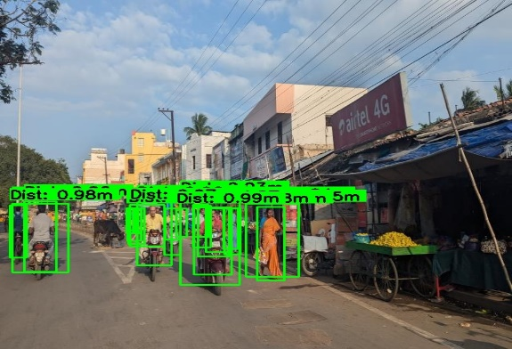
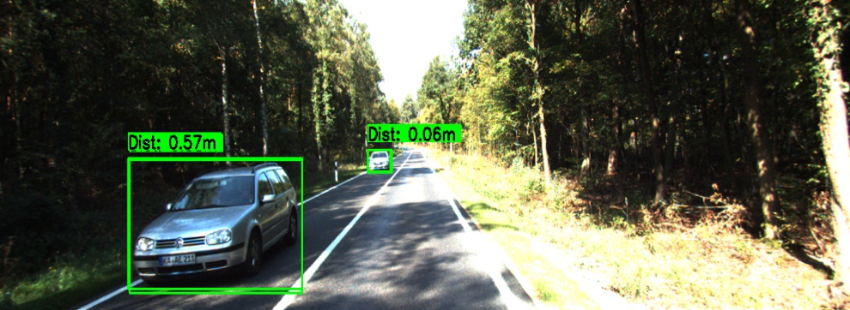
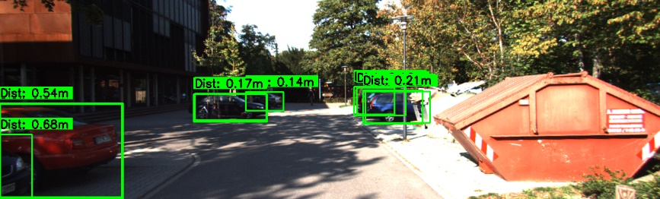
Implementation (Demo And Screenshots):
Object Detections and Distance Estimation:

Slide 29
CONCLUSION :
In this project, we developed and evaluated multiple deep learning models for object detection and distance estimation, using a combination of the KITTI dataset and a custom dataset (200–300 images). The models implemented included YOLOv5 (s, m, n, l variants), YOLOv8, SSD, and a Hybrid YOLOv5+YOLOv8 approach.
We successfully completed several important steps:
Data Collection and Preprocessing: including custom image augmentation (flipping, brightness changes, noise addition) and annotation formatting compatible with YOLO and SSD models.
Model Development and Training: leveraging pretrained weights and applying transfer learning on both datasets.
Distance Estimation, using depth estimation models guided by the detected object bounding boxes.
Performance Evaluation using key metrics: Precision, Recall, F1-Score, mAP@0.5, mAP@0.5:0.95, and Inference Time.

Slide 30
After evaluating all models, we found:
Best model in terms of accuracy: YOLOv5m, achieving the highest mAP scores with excellent precision, recall, and reasonable inference speed.
Best model in terms of speed: YOLOv8, offering the fastest inference time while maintaining good recall and detection accuracy.
Hybrid model performance: The Hybrid YOLOv5+YOLOv8 approach showed higher recall but lower precision and mAP, mainly due to the limited size (200–300 images) of the training data from both the KITTI and custom datasets.
Overall Best Model:
YOLOv5m was selected as the overall best model, especially when both accuracy and real-time efficiency are important for the application.

Slide 31
THANK YOU

